Slide 1
Multithreaded Processors

Slide 2
Multithreading
Performing multiple threads of execution in parallel
Replicate registers, PC, etc.
Fast switching between threads
Fine-grain multithreading
Switch threads after each cycle
Interleave instruction execution
If one thread stalls, others are executed
Coarse-grain multithreading
Only switch on long stall (e.g., L2-cache miss)
Simplifies hardware, but doesn’t hide short stalls (eg, data hazards)

Slide 3
Simultaneous Multithreading
In superscalar dynamically scheduled processor
Schedule instructions from multiple threads
Instructions from independent threads execute when function units are available
Within threads, dependencies handled by scheduling and register renaming
Examples:
Intel Xeon with Hyperthreading. Two threads: duplicated registers, shared function units and caches
IBM Power – 4 threads.

Slide 4
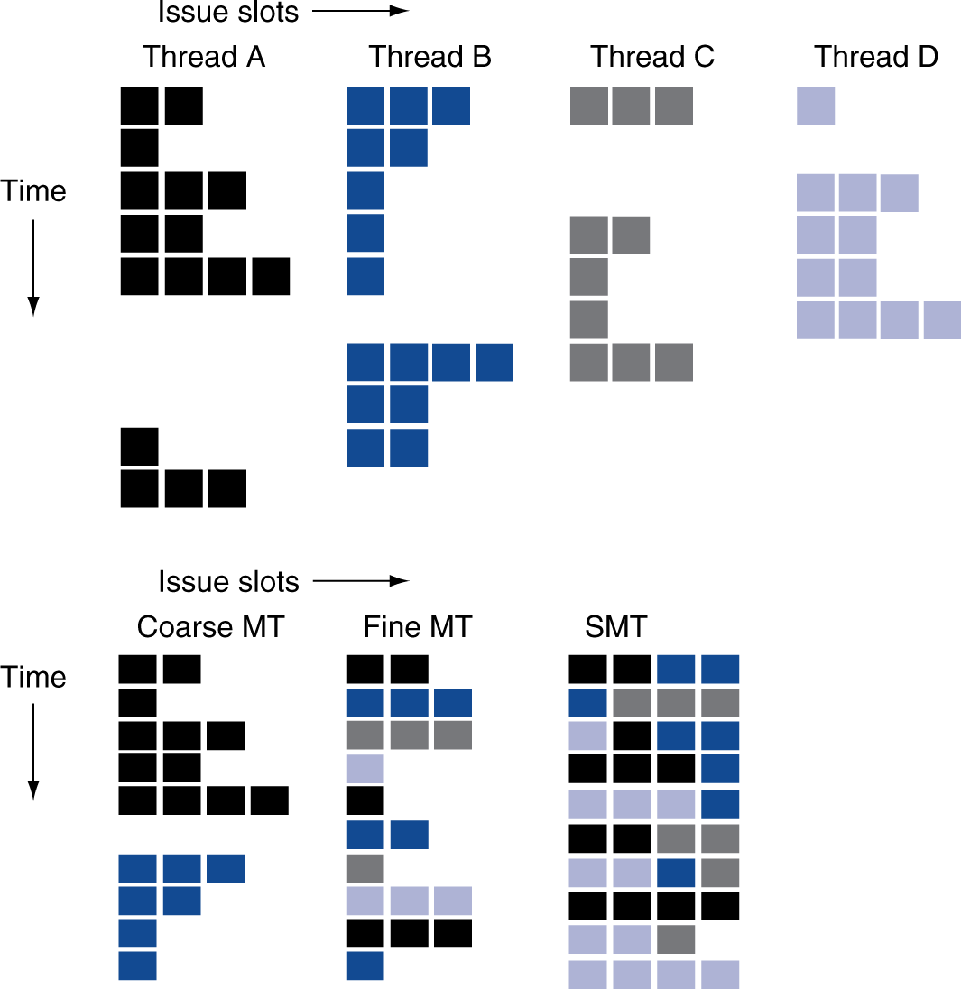
Multithreading Example

Slide 5
The SMT Datapath
Instruction
Cache
Issue Queue
Register
File
PC
PC
PC
Execution
Units
Data
Cache
Fetch
Unit
PC
PC
PC
PC
Load/Store
Queues
PC
LDST
Units
Decode
Register Rename
Re-order Buffers
Arch State
Private Resources
Shared Resources

Slide 6
SMT Key Design Issues
Preventing one thread from hogging the shared datapath resources, and thus denying them to the instructions from other threads
Previous techniques address this in one of two ways:
Indirectly via the use of various fetching policies
Directly via static partitioning of datapath resources, rather than complete sharing.

Slide 7
Future of Multithreading
Will it survive? In what form?
Power considerations ⇒ simplified microarchitectures
Simpler forms of multithreading
Tolerating cache-miss latency
Thread switch may be most effective
Multiple simple cores might share resources more effectively

